Slide 1
Integrated Rural Development: Towards A National Strategy in Egypt
Dr. M. A. Orabi
Sohag University
Egypt

Slide 2
Session Outline
Introduction
Traditional concept of Rural Development
Integrated R.D Model
Egypt`s Actions Towards IRD.
Conclusions
Discussions

Slide 3
Introduction
Rural development is a strategy designed to improve the economic and social life of rural population.
It is a process, which aims at improving the well being and self realization of people living outside the urbanized areas through collective process.

Slide 4
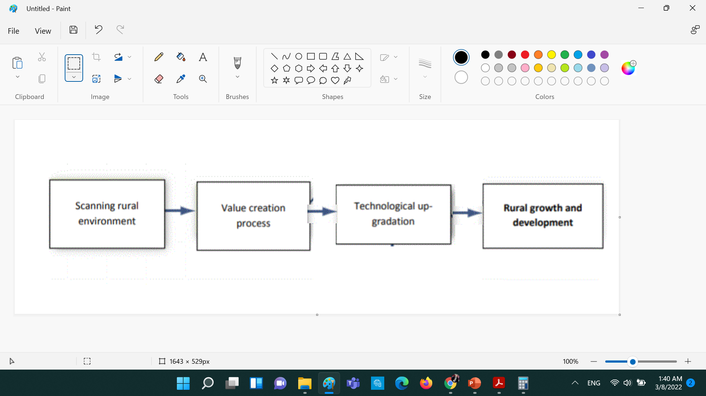
Traditional concept of Rural Development

Slide 5
Traditional concept of Rural Development
Rural development provides an alternative to agriculture as a source of incomes and livelihoods.
Rural development was traditionally associated with agriculture.
Reflects the complex linkages and interactions within the system of overall rural development.

Slide 7
Towards Integrated R.D Model
The policy shift towards integrated rural development.
Putting too much emphasis on agriculture with focusing on the allied sectors.

Slide 8
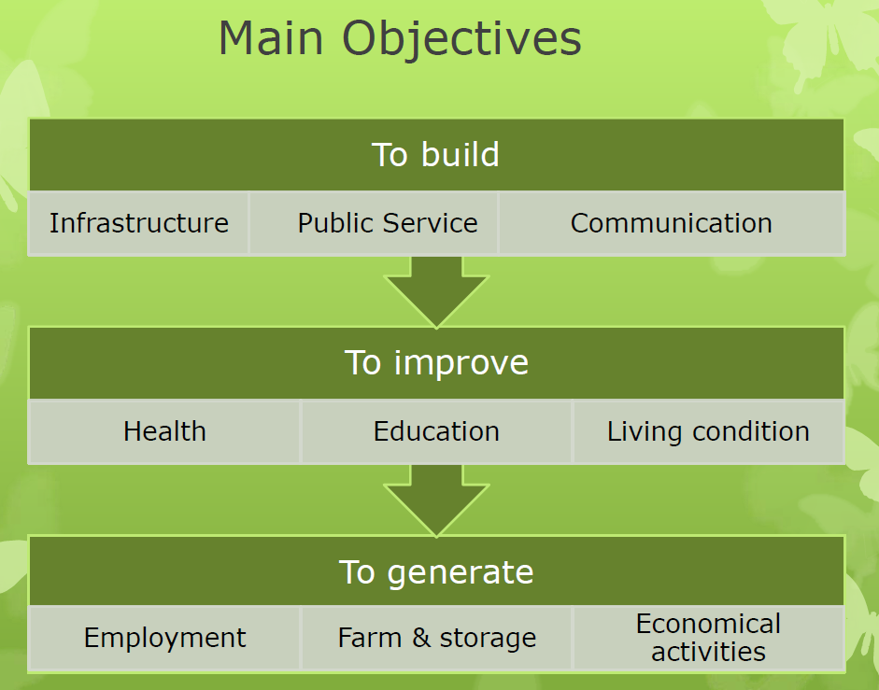

Slide 9
Constraints against the I.R.D.
1.People related
2. Agricultural related problems
3. Infrastructure related problems
4.Economic problems
5.Social and Cultural problems
6.Leadership related problems
7.Administrative problems

Slide 10
PEOPLE RELATED PROBLEMS..
Traditional way of thinking.
Poor understanding.
Low level of education to understand developmental efforts and new technology.
Deprived psychology and scientific orientation.
Lack of confidence.
Poor awareness.
Low level of education.
Existence of unfelt needs.
Personal ego.

Slide 11

Egyptian strategy for the IRD
Haya Karima (Decent Life Initiative) is not just an initiative..
It is the national initiative endorsed by H.E President Abdel Fattah Al-Sisi.
Integrated initiative in its features.
Stems from a civilized responsibility and a human dimension before anything else, as its goal is greater than just being an initiative aimed for improving the living conditions and daily life of Egyptian citizens.

Slide 12
it was necessary to move on a large scale - for the first time - and within a framework of integration and consolidation of efforts among the national state institutions, the private sector institutions, civil society, and the development partners in Egypt.

Slide 13
Why?
To consolidate & Integrate all the efforts of the Government, civil society, the private sector. With the aim of addressing multidimensional poverty and providing a decent life with sustainable development for the group most in need in the governorates of Egypt.

Slide 14
Comprehensive Process
For the first time at the public work level:
More than 20 ministries and agencies
23 civil society organizations
Meet to implement this IRD Initiative, with the help of Egyptian youth volunteering for charitable and development work through decent life institution.
4000 Targeted Villages

Slide 15
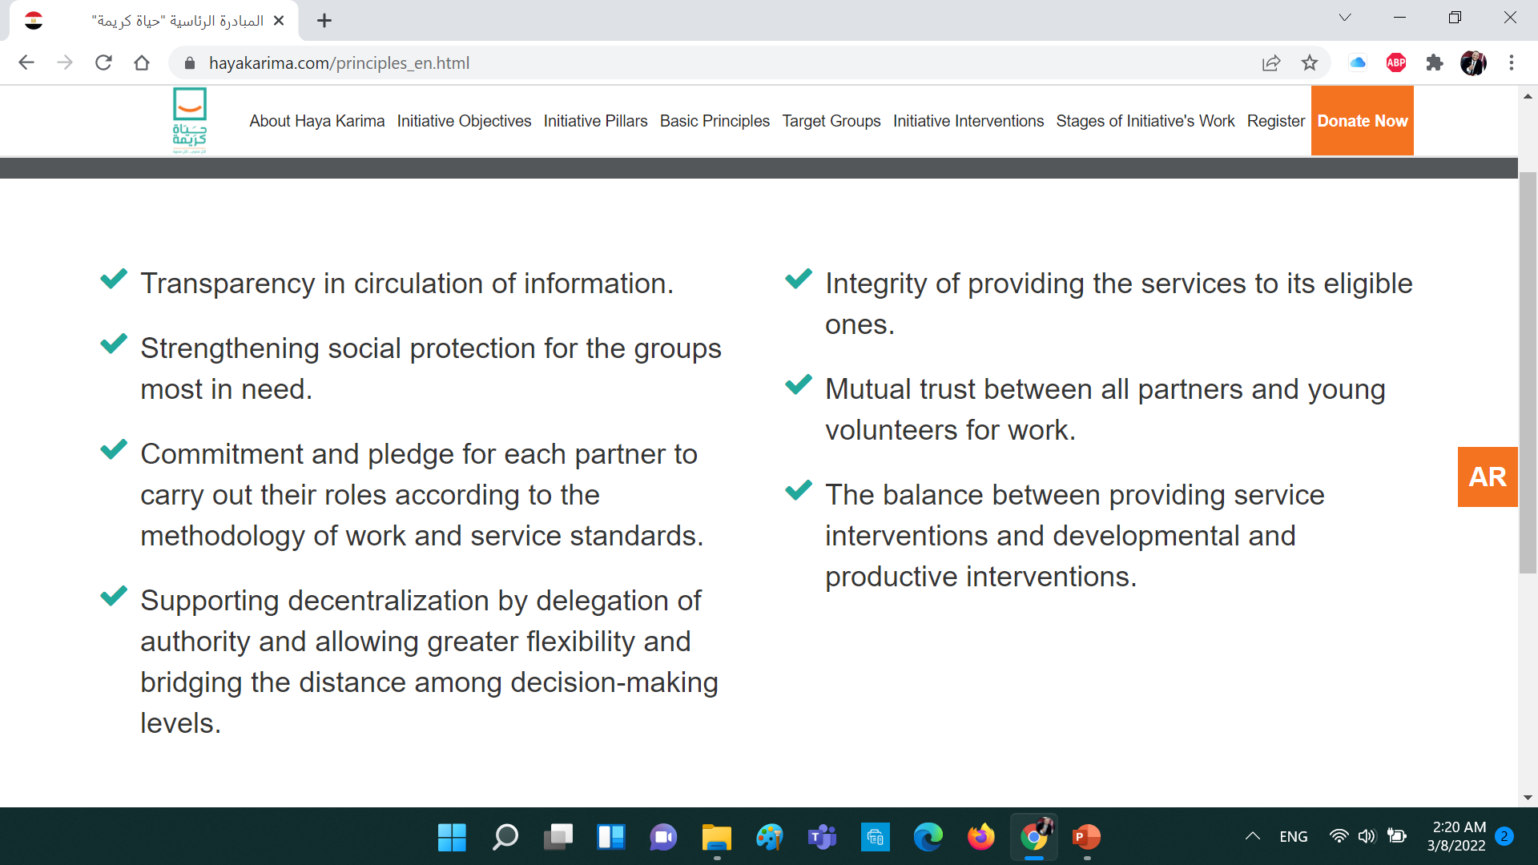
Basic Principles

Slide 16
Conclusions
The IRD is the concurrent suitable action needed all over the globe.
IRD is not just an action or list of demands.
The Developing country is urgently requested to move about the IRD.
Egyptian Concept for the RD has transformed to IRD

Slide 17

Discussions Time

Slide 18

Dr. M. A. Orabi
Sohag University
Egypt

